Slide 1


HDAG-EDTECH:
Automated Scoring Using
NLP and Machine Learning
Key insights from our team’s work with building automated tools to help teachers grade
May 2021
HDAG Group 2020 ® All Rights Reserved.
Notes:
Example title: New horizons in transportation: mobility, innovation, economic development and funding implications
Example subhead: How technology creates new opportunities across asset classes

Slide 2
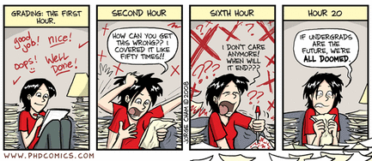


Why Is Essay Grading Hard??
It’s hard for computers to derive meaning from text. For example, it’s impossible for a computer to say: “Wow, that sentence was poetic!”
Different writing styles can be equally good but be assigned vastly different scores by the model.
Teacher grading is often extremely heterogeneous.
Different assignment types and grade levels can partition what is appropriate train data. Reduced amount of training data.
‹#›
Notes:
We found it frustrating that the simplest metrics were the best at prediction. For example simple word count metrics seemed to be the most useful for prediction (proxy for effort). The metrics that we invested the most time developing (such as passive voice, or other word similarity based metrics) frustratingly tended to perform the worst.

Slide 3
Summary
01
Text Featurization using NLP for Algorithmic Scoring and Highlighting
Text Featurization | Using the latest NLP techniques to generate numerical features representing writing quality.
Grading Model | Automated grading models so teachers and students have more scoring options, increasing writing opportunities.
Teacher Highlighting | Automatically present key facets of student writing, based on the rubric, for teachers for easier grading.
3

Slide 4



Text Featurization (NLP)
Text Featurization | Using the latest NLP techniques to generate numerical features representing writing quality. | COMPANY-provided metrics (word count, multiple choice score) Quantitative lexical & readability measures (Lexile, Flesch-Kincaid) Key phrase matching (transition phrases, vocabulary words)
Notes:
Add graphic here?

Slide 5
Text Featurization Process
All Features Listed
Feature Groups
TC-provided - school_class_grade_level, multiple_choice_score
Readability metrics (word/character_count, DaleChallIndex, syll_per_word)
Phrase matching - ex: total_transition_matches, num_contractions
char_count word_count sentence_count Kincaid ARI Coleman-Liau FleschReadingEase GunningFogIndex LIX SMOGIndex RIX DaleChallIndex characters_per_word syll_per_word words_per_sentence sentences_per_paragraph type_token_ratio characters syllables words wordtypes | sentences paragraphs long_words complex_words complex_words_dc num_passive num_contractions student_assignment_id school_class_grade_level student_assignment_grade_level multiple_choice_score contrast_transition_matches summary_transition_matches explaination_transition_matches total_transition_matches

Slide 6
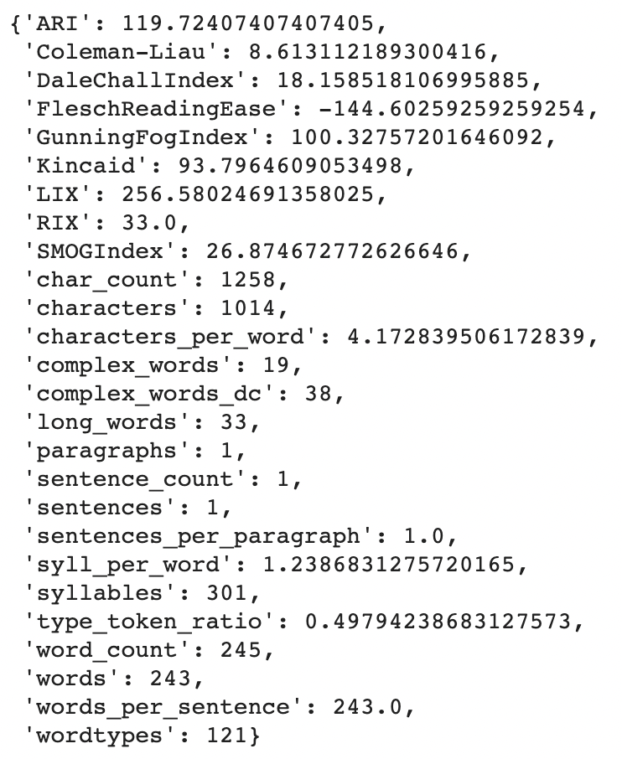
Readability Features (FleschReadingEase, Kincaid, syllables per word, wordtypes, etc.)
How it works:
Input student writing sample as string into Python’s readability package
Ex: “Once upon a time there was a utopian society where everyone got along no one would ever argue or fight and this society was hidden form the rest of the world but one day there was a crack in the barrier that hid them from the rest of the world and someone stumbled across it so instead of exploring alone the man who found the crack told 9 other people and the next day they returned to the crack in the barrier they examined the type of clothes that the people would wear and replicated them then one day they decided to rob a bank and due to it being such a peacful place there where no cameras, they felt they had no need for them so eyewitnesses would blame anyone they thought the suspects looked like and this led to many conflicts loss of freindships and much more so the society created a type of police system to find out who robbed the bank so at the end of the month the people found who was responsible for the bank robery and everyone who blamed anyone apologized everyone forgave everyone and they all went back to living their normal lives in peace but they had to find the crack in the barrier it took hours then one of the people fond it they fixed the barrier and now have a barrier watch so that no dilema like this cold ever happen again."
12

Slide 7
Key Phrase Matching Features (Transition/Vocab Words, Sentence Stems, Passive Voice)
How it works:
SpaCy creates a Doc object out of the text sample, creating individual “tokens” out of each of the words.
Then, our function takes in a vocab list (transition word, sentence stem, or vocab list) and creates patterns out of them.
Then, SpaCy’s Matcher object can record all of the matches. We count them.
writing_doc = nlp(essay)
for phrase in cerca_words:
pattern = []
phrase = phrase.split()
for word in phrase:
pattern.append({"LOWER" : word})
vocab.append(pattern)
cerca_matches = m_tool(sample)
Matcher also tags each word with its function in the sentence, enabling us to count passive subjects
12

Slide 8
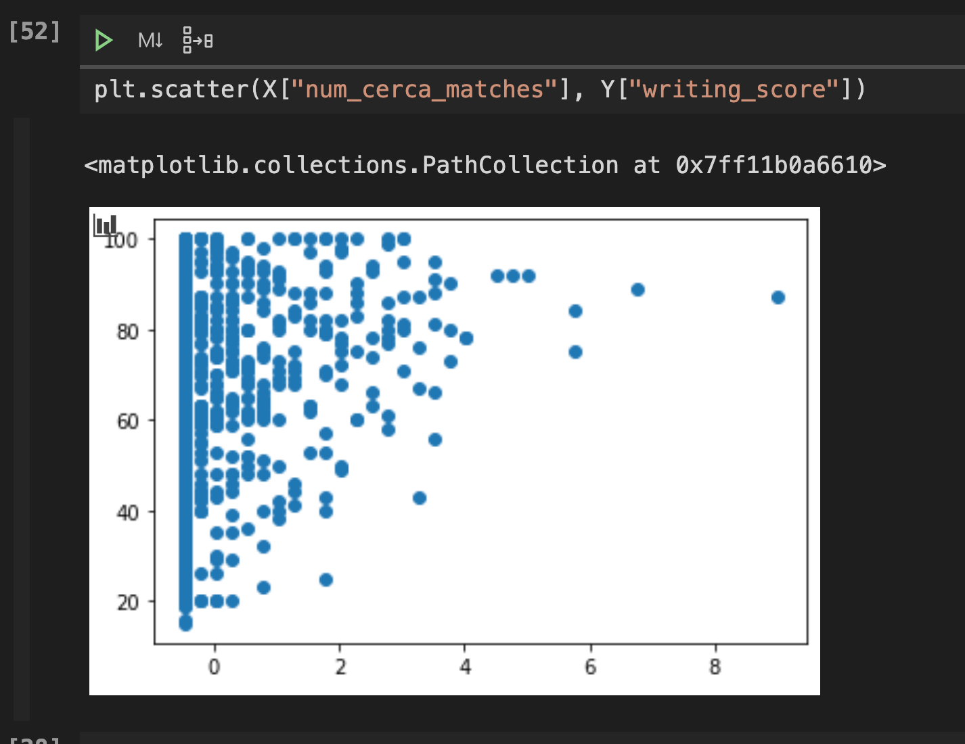
Regression with Key Vocab Words - Results
As we can see, the number of key vocab words is slightly correlated with the writing score.
We found that our model provided us better results when vocab word matches was used as a feature in conjunction with other features.
This is because a lot of students who didn’t use any keywords still were able to achieve high scores.
However, there is still a minor positive correlation.

Slide 9
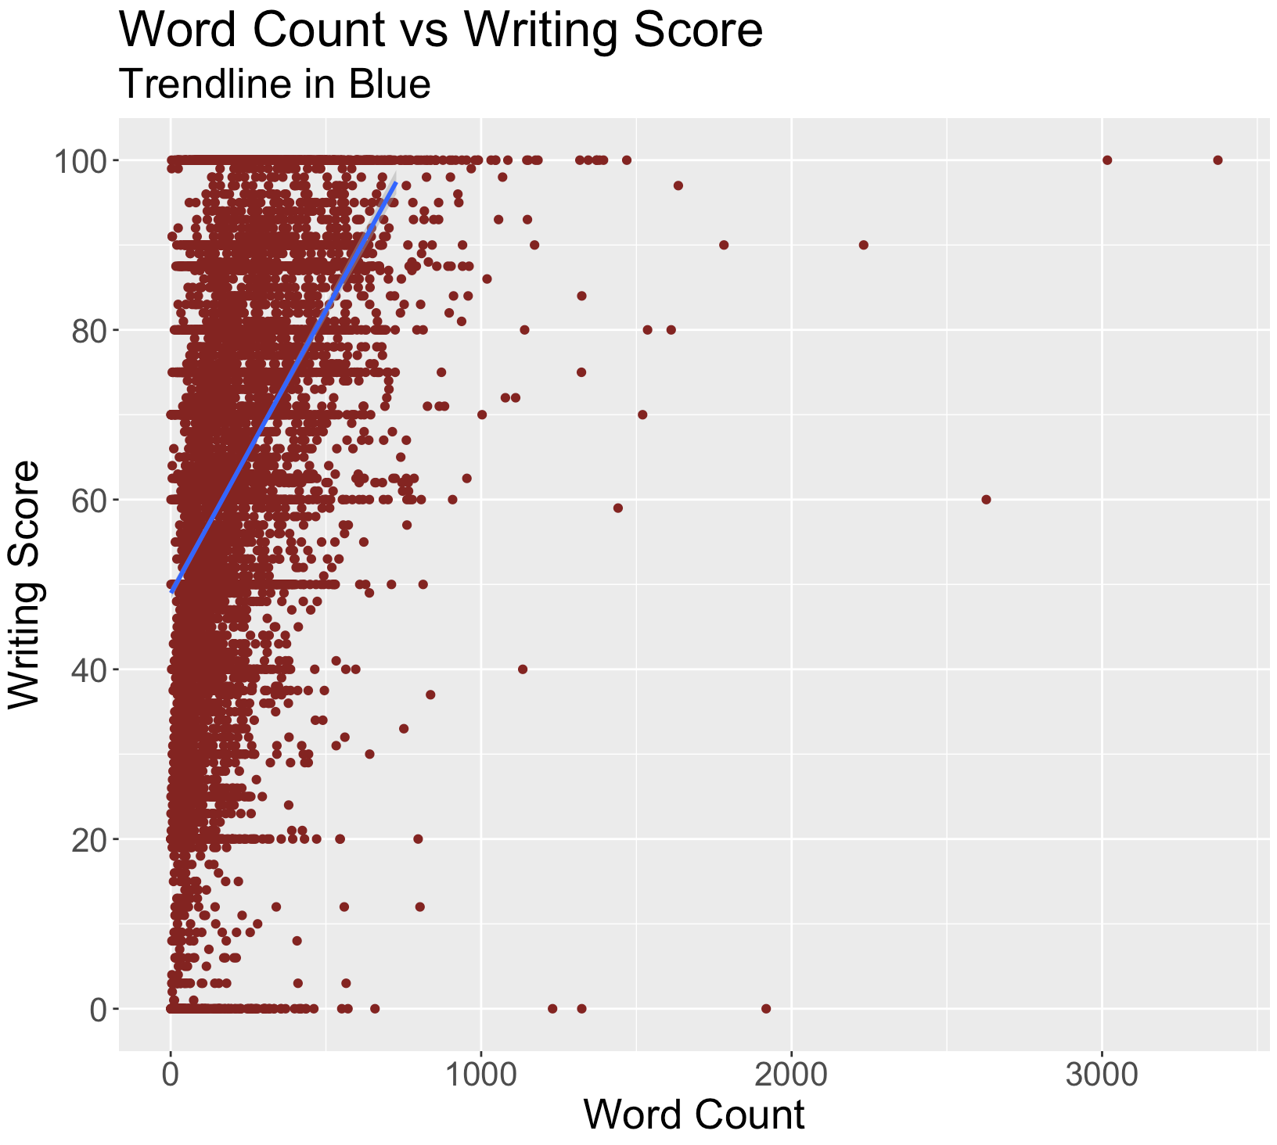
Word Count as a Predictor of Score
In a world of writing where effort can be in short supply, (50% of grades were less than a 65/100), simple metrics such as word count, characters per word, and sentence count had strong correlations with essay score.
Notes:
Could threshold to like 95% of data and get better looking trendline

Slide 10
Feature Importance
R Squared | Feature
0.22 | Character Count
0.21 | Word Count
0.18 | Sentence Count
0.079 | Kincaid
0.064 | ARI
0.00044 | Coleman.Liau
0.084 | FleschReadingEase
0.077 | GunningFogIndex
0.08 | LIX
0.1 | SMOGIndex
0.077 | RIX
0.08 | DaleChallIndex
0.075 | Words Per Sentence
0.036 | Sentences per Parahraph
0.26 | Type Token Ratio
0.022 | paragraphs
0.2 | Long Words
0.16 | Complex Words
R Squared | Feature
0.0012 | Grade Level
0.026 | Institution ID
0.058 | Multiple Choice Score
0.075 | Contrast Transition Matches
0.056 | Summary Transition Matches
0.038 | Explanation Transition Martches
0.1 | Total Transition Matches
0.078 | Passive Voice
Relative to other metrics, measures of length such as character count, syllables, and word count are strong predictors of writing score. Readability metrics such as Gunning Fog Index and type_token_ratio were also important in our modeling
Note: These variables may have covariance - features are not necessarily independent of each other (ex. character count and word count are highly correlated).

Slide 11
Grading Model (ML)
Grading Model | Automated grading models so teachers and students have more scoring options, increasing writing opportunities. | Linear Regression & Classification Random Forest Regression & Classification Neural Network Model Regression

Slide 12
“Grade Bucketing” Approach
Predict Score with
Regression Model
Sort into
“Grade Buckets”
Display Predicted
Grade Bucket to Teacher
Run a regression model with a numeric score for a student writing sample (0-100) as output (linear regression, random forest regression)
Sort this 0-100 into “grade buckets” - users can customize the number of buckets and also the thresholds for each bucket (equally sized, or manually set boundaries)
Display predicted “grade bucket” to teacher - this provides a suggestion to the teacher, but allows for more flexibility for teacher discretion

Slide 13
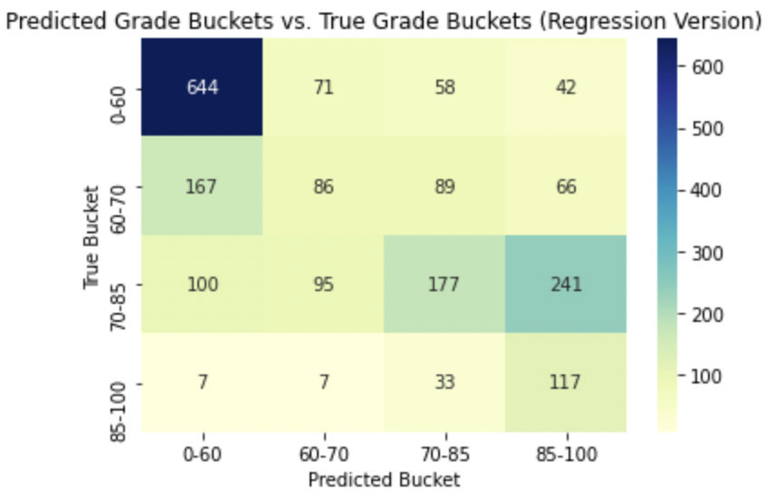
Grade Bucketing Results
Results
Explained R^2 of regression model (without bucketing) = 0.48
After sorting into buckets, our bucketing model correctly buckets 51% of student assignments
Correctly bucketed 86% of assignments within one bucket of correct
Note: The model seems to bias upwards for high-scoring essays and downwards for lower-scoring essays (ie. clumping in 0-60 and 85-100).

Slide 14
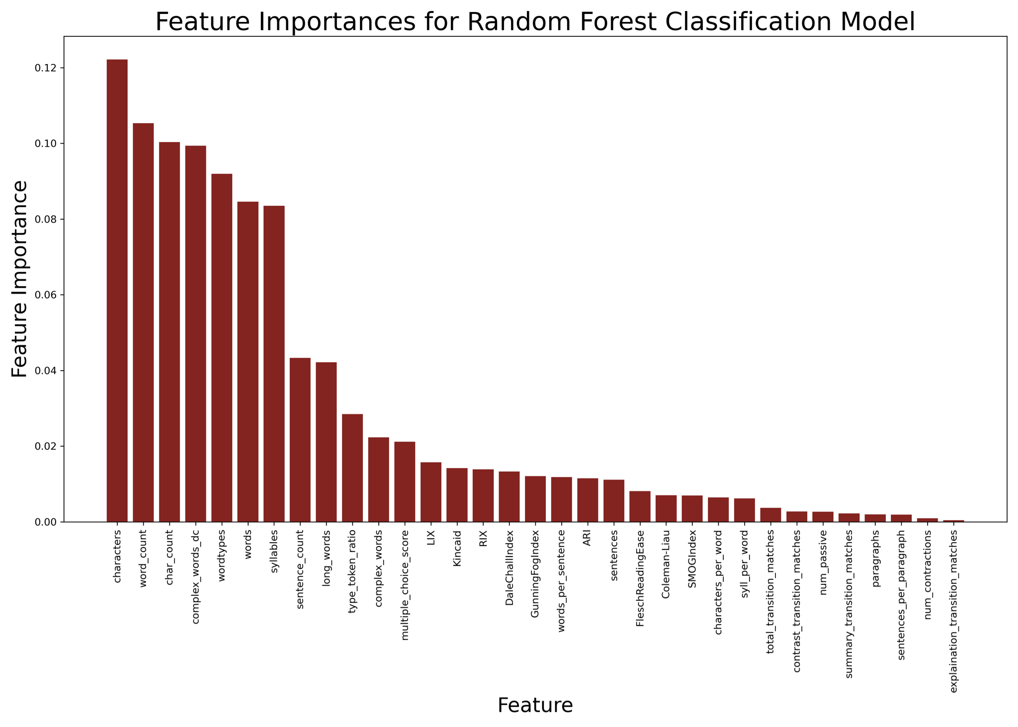
Random Forest Classification Model
Trained a RF classification model on our cleaned dataset of metrics by assigning categorical grades
Model uses a collection of decision trees to partition the metric space.
We got an accuracy score of over 40% with most other scores falling in neighboring bins. (Eg model may erroneously assign a “B” paper an “A”)
‹#›
Notes:
We found it frustrating that the simplest metrics were the best at prediction. For example simple word count metrics seemed to be the most useful for prediction (proxy for effort). The metrics that we invested the most time developing (such as passive voice, or other word similarity based metrics) frustratingly tended to perform the worst.

Slide 15
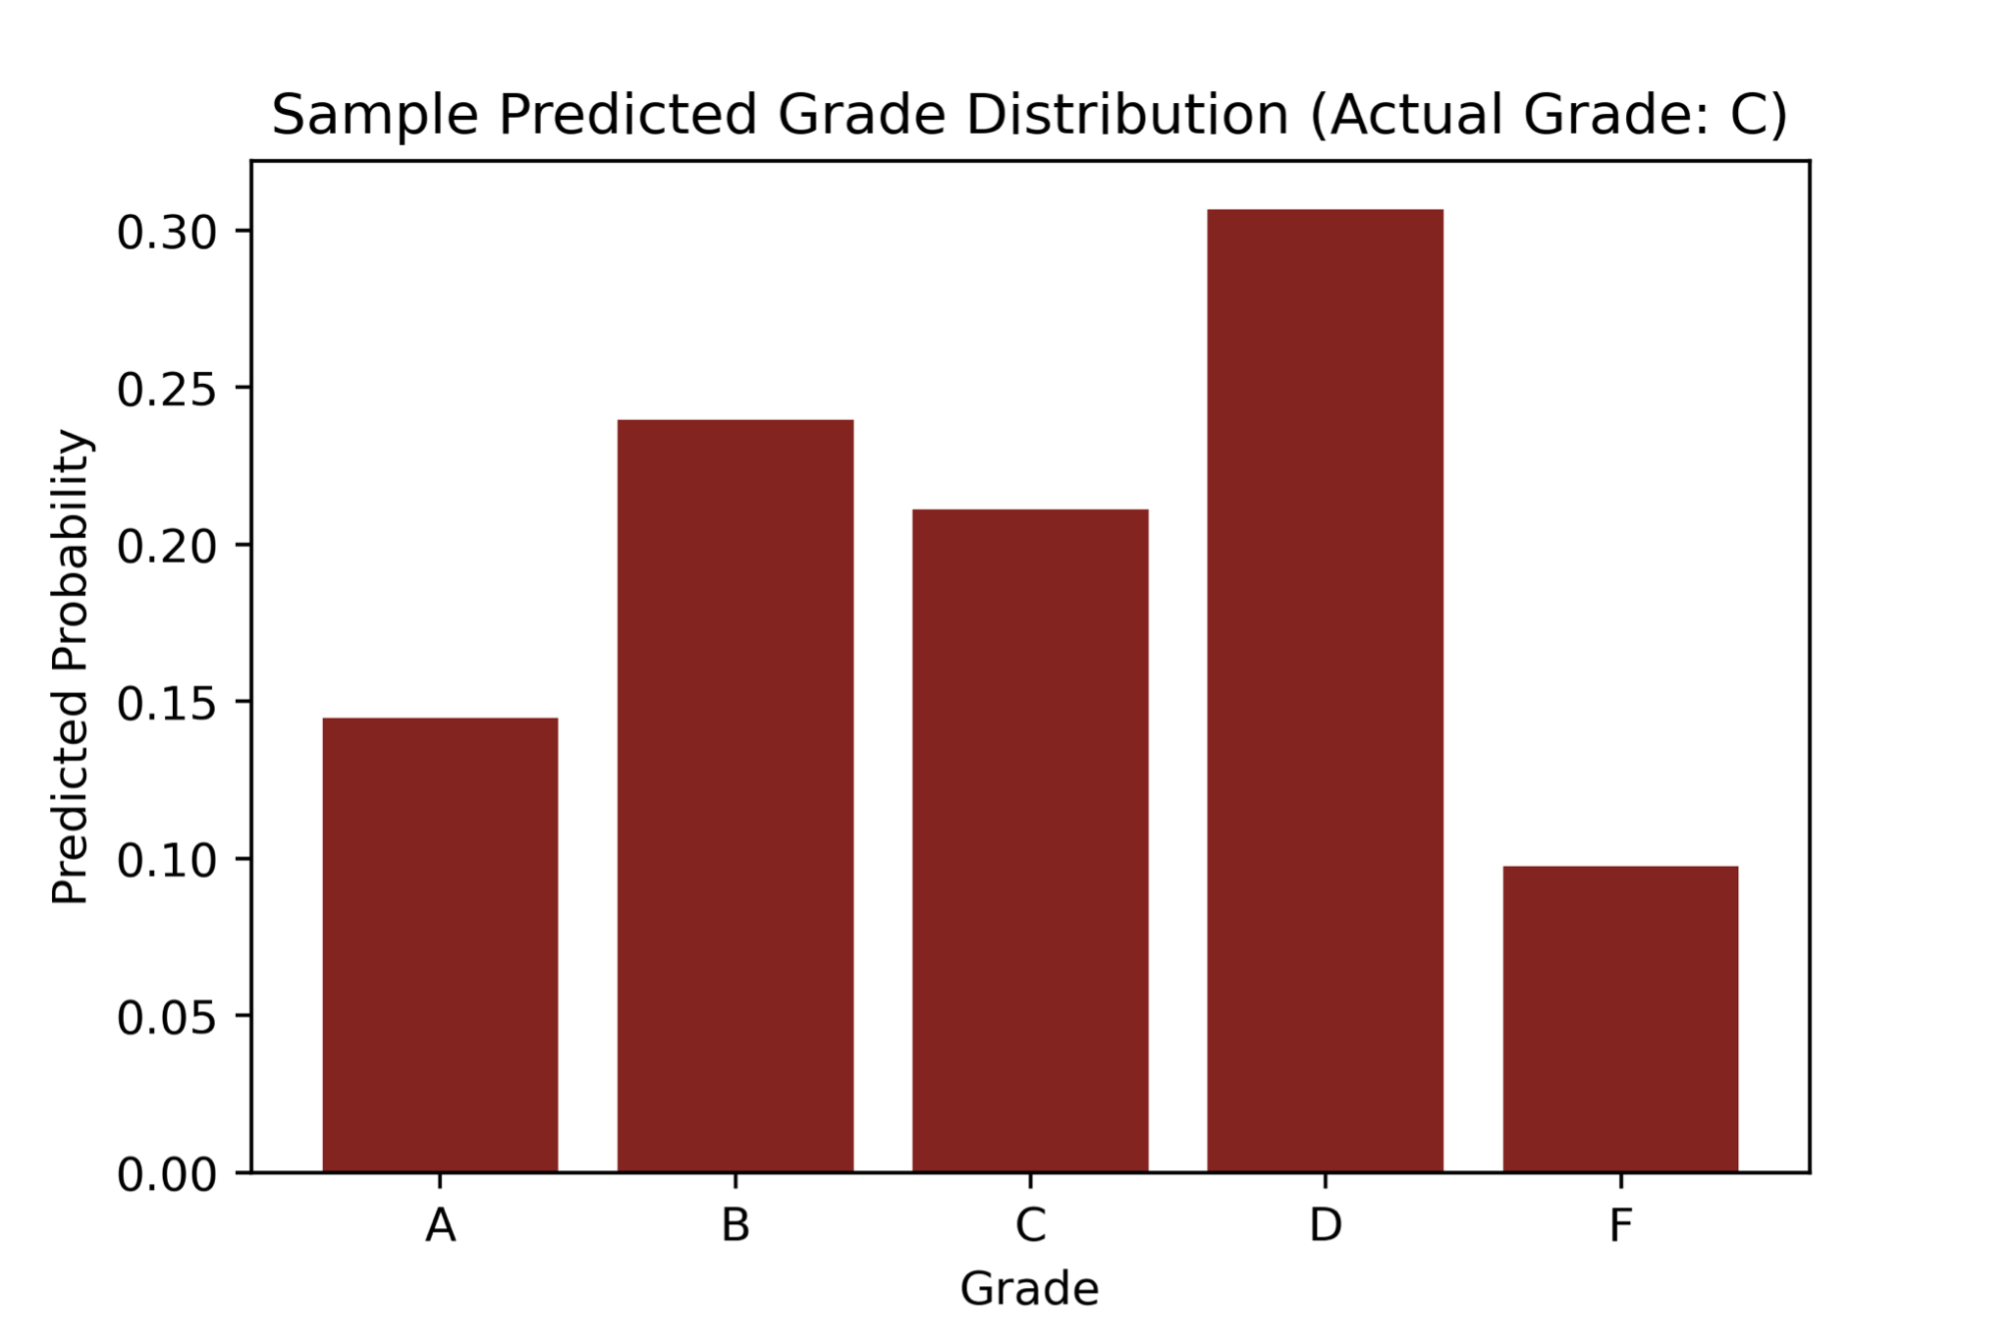
Example Classification Model Use
We envision this model acting as a guide for teachers – helping them gage where their student is performing but not being overly deterministic.
Possible Workflow to reproduce:
Take an essay and compute metrics
Load pre-computed model
Predict score from metrics using the model and visualize
‹#›
Notes:
No predictive power would have all columns at 0.2. We would like to see more convergence to a single category (eg D > 0.7) which would tend to indicate a stronger model.

Slide 16
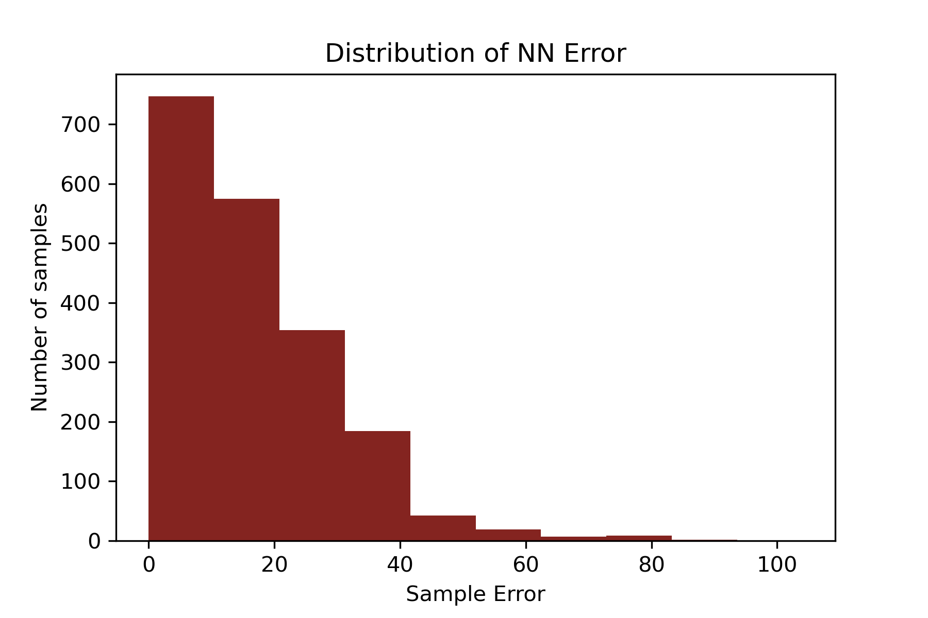
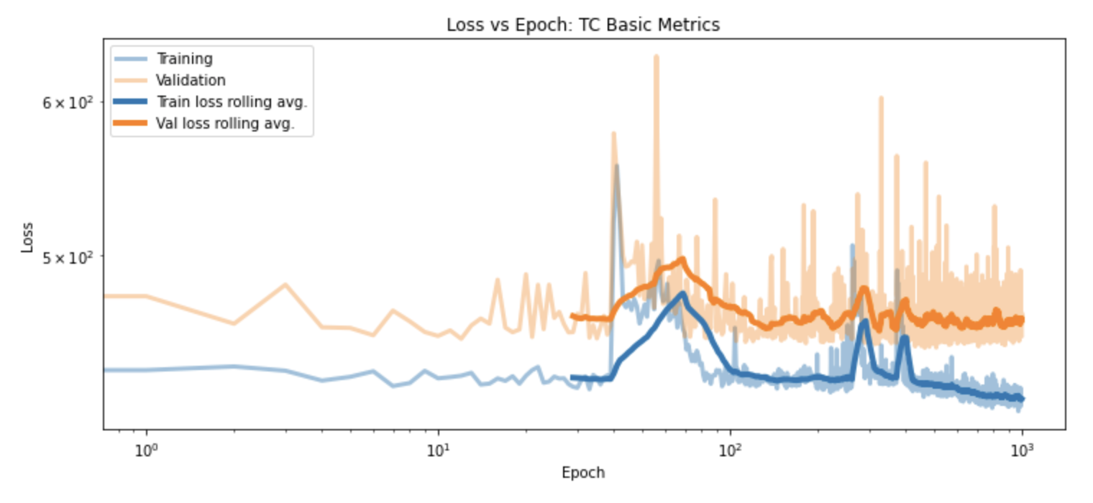
Neural Network Model
We implemented a simple dense, feed-forward neural network with 1 hidden layer for 1000 epochs.
In comparison with a linear regression, the neural network model reduced predictive error by almost a factor of 2.
The linear regression was only able to predict 35% of scores within 10 points (one letter grade), while the neural network categorized over 65% of scores accurately! At the 20 point level, the LR scored only 65% while the neural network captured 82% of scores!
‹#›

Slide 17
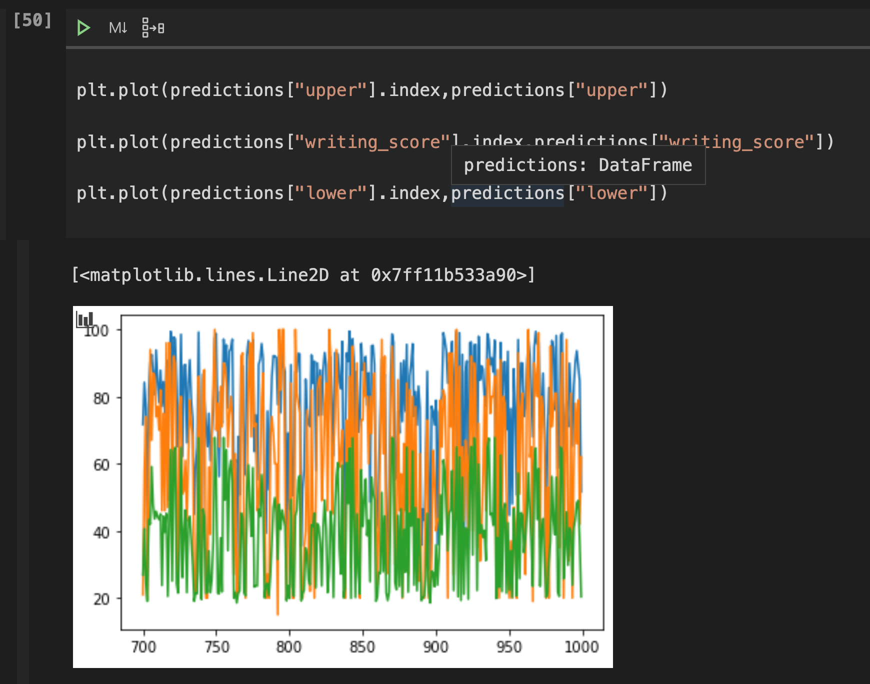
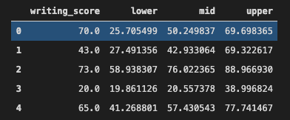
Prediction Intervals
Created “confidence interval” regression using scikit-learn Gradient Boosting Regressor
With 80% coverage, average interval width ~40 points - large variance within dataset with highly accurate predictions (rows 1-3 below) and inaccurate (row 0)
‹#›

Slide 18
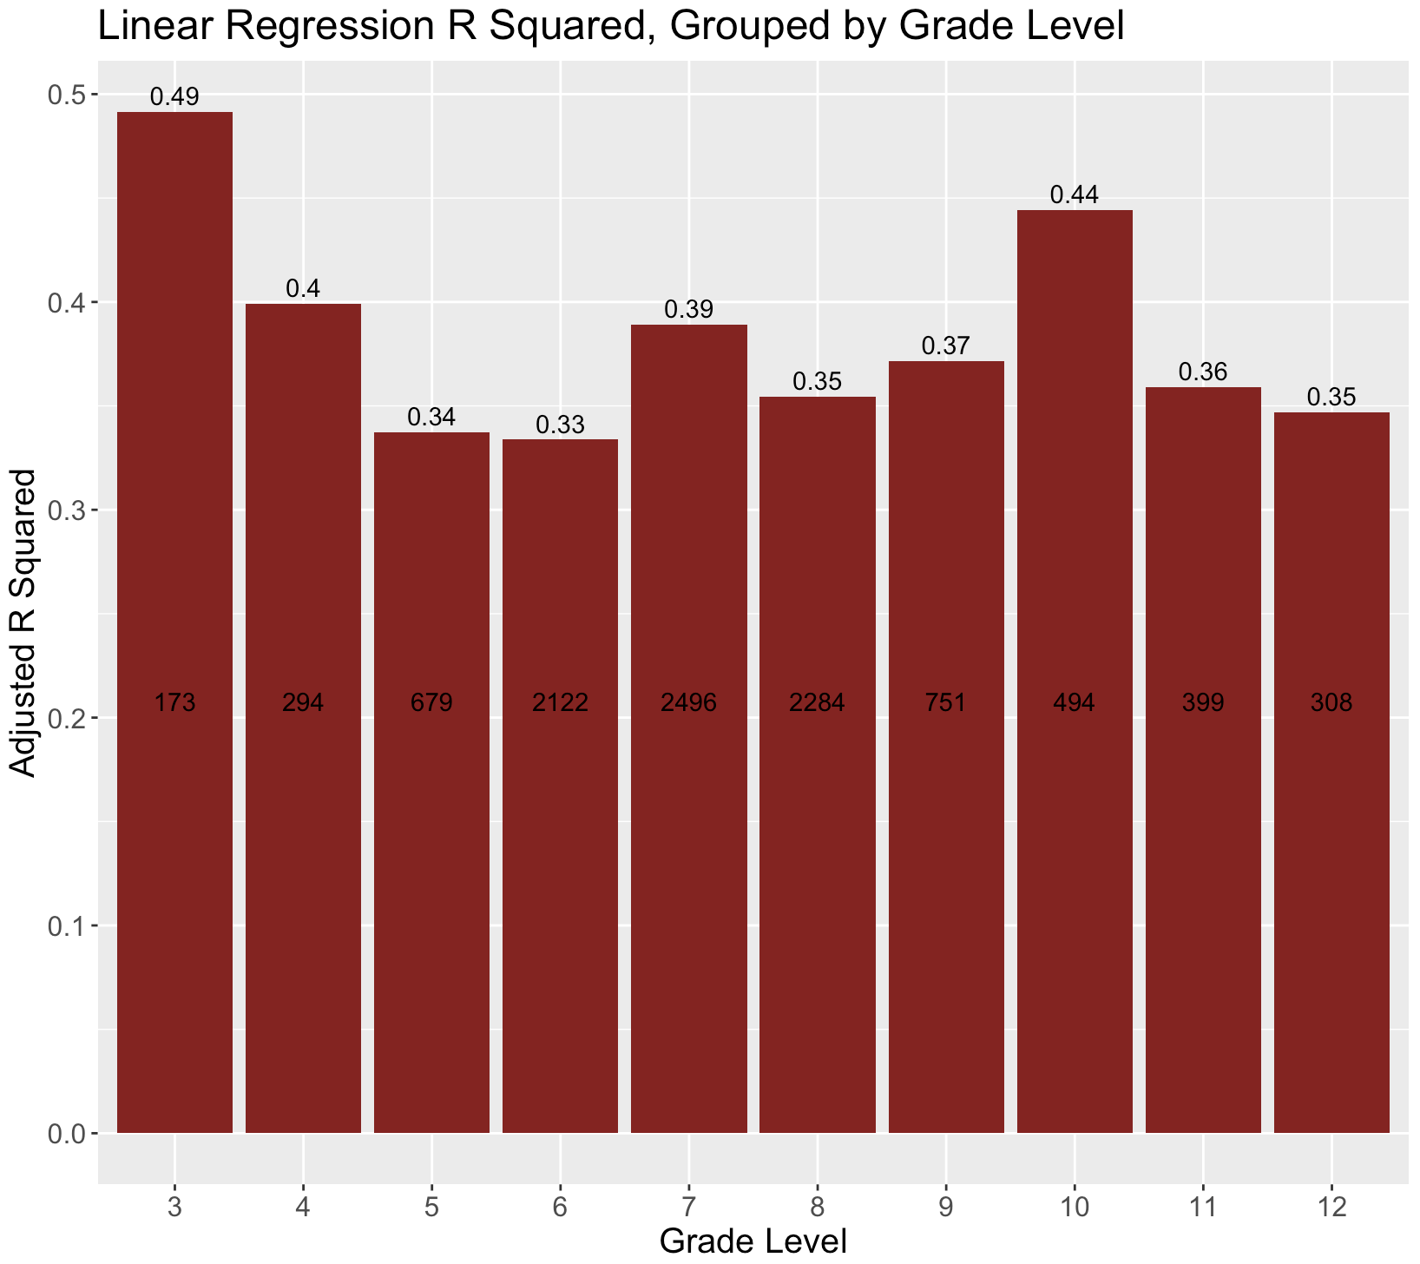
Factors influencing model fit
A byproduct of the product’s wide educational reach is an extremely heterogeneous pool of students and graders. Even when we organized students into smaller, more homogenous groups (i.e. same grade and district) model fit was quite variable.

Slide 19
LATENT DIRICHLET ALLOCATION (LDA) MODEL
STUDENT WRITING
(Text Corpus)
DATA PRE-PROCESSING
Sentence to words
Lemmatize words
Remove Punctuation
Remove Stopwords
MAKE BIGRAMS
Two word frequencies
MAKE TRIGRAMS
Three-word Frequencies
DICTIONARY OF WORDS
LDA MODEL
TOPICS
COHERENCY SCORES
PERPLEXITY SCORE
Coherency Score: score measuring semantic similarity between words.
Perplexity Score: measure of how well the probability model predicts topics from the sample.

Slide 20
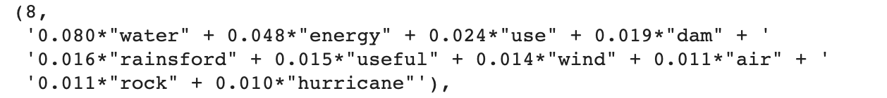
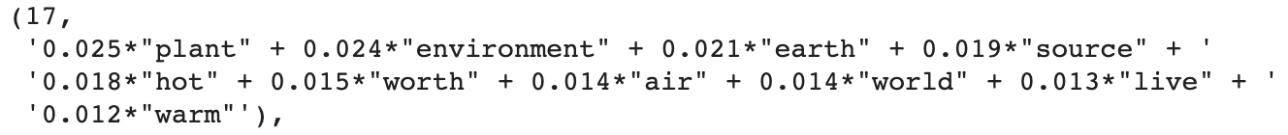
PERFORMANCE MEASURES
Coherency Score
Measures semantic similarity of words from the same topic that the student has used.
The weights on each word reflect how important a keyword is to that topic.
Energy Sources
Climate
Global Warming

Slide 21
FUTURE RECOMMENDATIONS
Prediction Stage
Use the model to make predictions on individual student essays
3
Working Model
Now we have a trained Model that gives coherency scores and topics for the whole Data set.
2
Base Level
Used the entire Data set and evaluate the set of possible topics.
1

Slide 22
Teacher Highlighting
Teacher Highlighting | Automatically present key facets of student writing, based on the rubric, for teachers for easier grading. | Key metrics + percentiles (word count, Kincaid Grade Level, etc.) Transition words, misspellings, vocab words CERCA facets separated (delineate claims, evidence, reason, etc.)

Slide 23
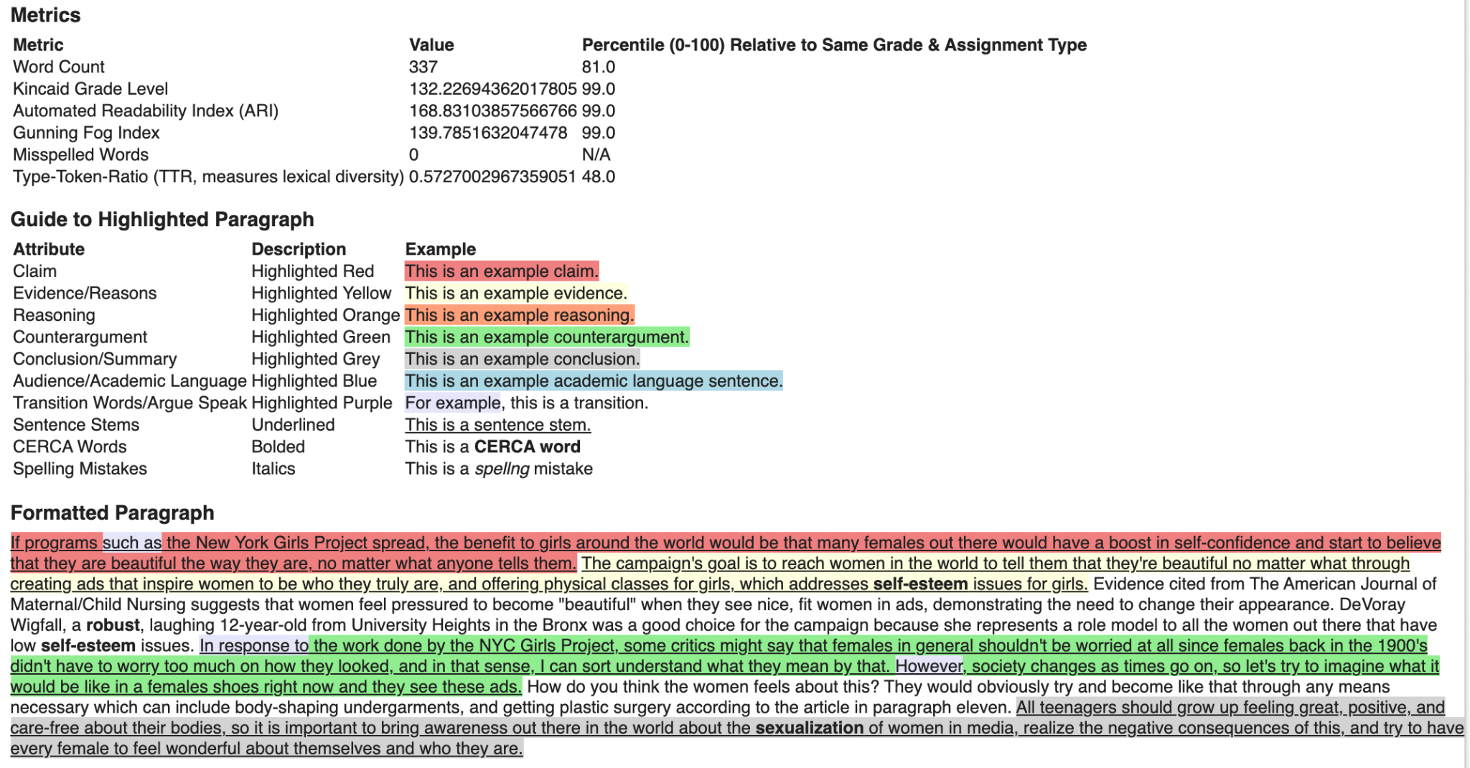
Compare Metrics to Other Assignments in Same Grade/Assignment Type
Metrics for Teachers to Use
Teacher Highlighting on Real Student Writing Sample
Sentence fitting claim sentence stem from lesson - highlighted red
Vocab words from lesson information

Slide 24
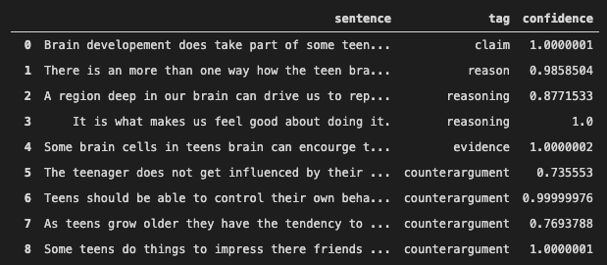
Argument Builder Matching
Use sentence similarity metrics to recover, based on the student’s writing and their argument builder, which portions of their essay they intend to be their claim, reasoning, etc.
Most students copy their argument builder verbatim
Similarity metrics enable fuzzier matching
Mostly, this covers small grammar changes and semantic differences
Unlike word count, the number of argument builder matches in an essay did not strongly correlate with score.

Slide 25
Disclaimer
This report is confidential and shall not be shared. All client sensitive and privileged information was removed. Several sections of the report were intentionally removed due to confidentiality and intellectual property issues.
2

